Slide 1
Big Data
Aims to:
Find new and better ways to manage large amounts of web and sensor-generated data
Provide high performance and scalability at a reasonable cost
Characteristics
Volume
Velocity
Variety

Slide 2
Examples of Bid Data in realworld
Big Data Contributions to Learning—blogs
Big data contributions to Healthcare---evidence based medicine
Big data contributions in Private sector--Power investigation
Big Data Contributions to Communications, Media and Entertainment---Amazon Prime
Weather patterns---Forcast
Big Data Contributions to Transportation---Intelligent transport systems
Big Data Contributions to Banking Zones and Fraud Detection

Slide 3
Big Data New Technologies
Hadoop
Hadoop Distributed File System (HDFS)
MapReduce
NoSQL

Slide 4
Hadoop is an open source distributed processing framework that manages data processing and storage for big data applications running in clustered systems.
MapReduce is a programming model and an associated with implementation for processing and generating big data sets with a parallel, distributed algorithm on a cluster.

Slide 5
NoSQL Databases
NoSQL (is Not only SQL)
Not based on the relational model
Support distributed database architectures
Provide high scalability, high availability, and fault tolerance
Support large amounts of sparse data
Geared toward performance rather than transaction consistency
Store data in key-value stores

Slide 6
Eliminating Anomalies from Multivalued Dependencies
Multivalued dependencies are not a problem if they are in a separate relation, so:
Always put multivalued dependencies into their own relation.
This is known as Fourth Normal Form (4NF).

Slide 7
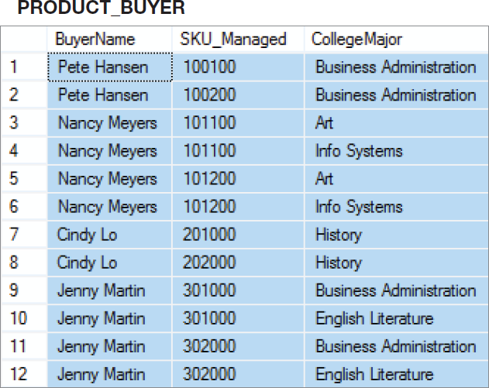
That Very Strange Table Again
Now we understand why this is a very strange table.
It has multivalued dependencies!
Notes:
To understand why this is an odd table, suppose that Nancy Meyers is assigned a new SKU, say 101300. What addition should we make to this table?
Clearly, we need to add a row for the new SKU, but if we add just one row, say the row ('Nancy Meyers', 101300, 'Art'), it will appear that she manages product 101300 as an Art major, but not as an Info Systems major.
To avoid such an illogical state, we need to add two rows:
('Nancy Meyers', 101300, 'Art') and ('Nancy Meyers', 101300, 'Info Systems').
Now, that is strange!

Slide 8
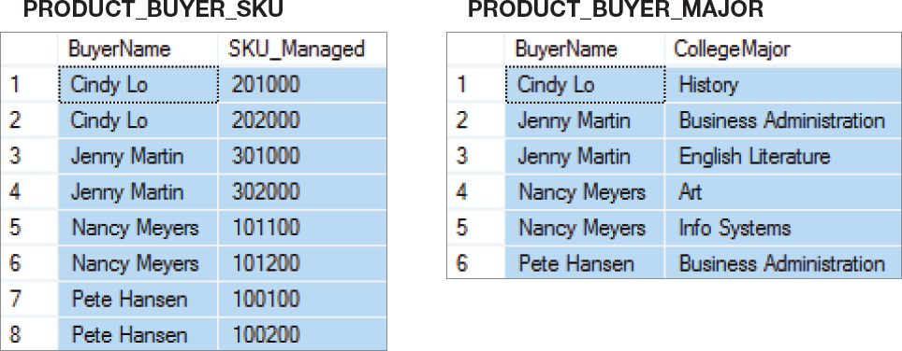
4NF
Use 4NF to resolve the multivalued dependencies!

Slide 9
Denormalization
Normalization is one of many database design goals.
However, normalized tables result in:
additional processing
loss of system speed
When normalization purity is difficult to sustain due to conflict in:
design efficiency
information requirements
processing speed
Denormalize by
use of lower normal form
use of controlled data redundancies

Slide 10
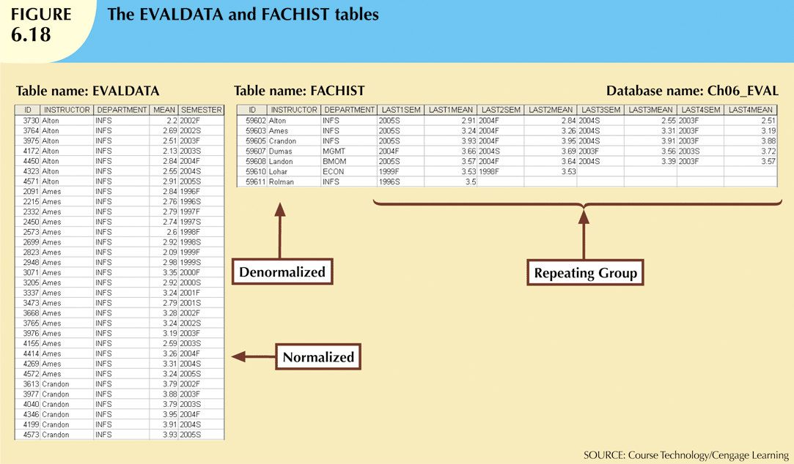

Slide 11
Structured Query Language
SQL commands are instructions used to communicate with the database to perform specific task that work with data.
SQL commands are grouped into four major categories
Data Definition Language (DDL)
Data Manipulation Language (DML)
Transaction Control Language (TCL)
Data Control Language (DCL)

Slide 12
Structured Query Language
Data Definition Language (DDL)
These SQL commands are used for creating, modifying, and dropping the structure of database objects.
The commands are
CREATE,
ALTER,
DROP,
RENAME, and
TRUNCATE.

Slide 13
Structured Query Language
Data Manipulation Language (DML)
These SQL commands are used for storing, retrieving, modifying, and deleting data.
These commands are
SELECT,
INSERT,
UPDATE, and
DELETE.

Slide 14
Structured Query Language
Transaction Control Language (TCL)
These SQL commands are used for managing changes affecting the data.
These commands are
COMMIT,
ROLLBACK, and
SAVEPOINT.
Data Control Language (DCL) - These SQL commands are used for providing security to database objects. These commands are GRANT and REVOKE.

Slide 15
COMMIT
COMMIT command is used to permanently save any transaction into the database.
When we use any DML command like INSERT, UPDATE or DELETE, the changes made by these commands are not permanent, until the current session is closed, the changes made by these commands can be rolled back.
To avoid that, we use the COMMIT command to mark the changes as permanent.

Slide 16
SAVEPOINT
SAVEPOINT command is used to temporarily save a transaction so that you can rollback to that point whenever required.
name
In short, using this command we can the different states of our data in any table and then rollback to that state using the ROLLBACK command whenever required.

Slide 17
ROLLBACK
This command restores the database to last committed state. It is also used with SAVEPOINT command to jump to a savepoint in an ongoing transaction.
If we have used the UPDATE command to make some changes into the database, and realize that those changes were not required, then we can use the ROLLBACK command to rollback those changes, if they were not commited using the COMMIT command.

Slide 18
Using Savepoint and Rollback Following is the table class,
id | name
1 | Abhi
2 | Adam
4 | Alex

Slide 19
INSERT INTO class VALUES(5,'Rahul');
COMMIT;
UPDATE class SET name = 'Abhijit' WHERE id = '5';
SAVEPOINT A;
INSERT INTO class VALUES(6, 'Chris');
SAVEPOINT B;
INSERT INTO class VALUES(7, 'Bravo');
SAVEPOINT C;
SELECT * FROM class;

Slide 20
The resultant table will look like,
id | name
1 | Abhi
2 | Adam
4 | Alex
5 | Abhijit
6 | Chris
7 | Bravo

Slide 21
Now let's use the ROLLBACK command to roll back the state of data to the savepoint B.
ROLLBACK TO B; SELECT * FROM class;
Now our class table will look like,
id | name
1 | Abhi
2 | Adam
4 | Alex
5 | Abhijit
6 | Chris

Slide 22
Now let's again use the ROLLBACK command to roll back the state of data to the savepoint A
ROLLBACK TO A; SELECT * FROM class;
,
id | name
1 | Abhi
2 | Adam
4 | Alex
5 | Abhijit

Slide 23
TCL----GRANT and REVOKE
GRANT CREATE TABLE TO username;
REVOKE CREATE TABLE FROM username

Slide 24
Subquery
NULL Functions
DECODE
The DECODE function have 3 parameters.
If second parameter occurs will replace to third parameter
Other wise it return NULL
SELECT COL1,DECODE(COL2,NULL,'AJI') AS OUTPUT FROM N_TEST;
Here all NULL, converted to ‘AJI’ other wise it converted to NULL

Slide 25
Advanced SQL Elements
A View is a “virtual” table that can contain data from multiple tables
A Stored Procedure is like Method in C# - it is a piece of code with SQL commands that do a specific task – and you reuse it
A Trigger is executed when you insert, update or delete data in a Table specified in the Trigger.

Slide 26
CURSORS
A cursor is a private set of records
A cursor is a database object which is used to retrieve data from resultset one row at a time.The cursor can be used when the data needs to be updated row by row. A cursor is declared by defining the SQL statement. Acursor is opened for storing data retrieved from the result set
An Oracle Cursor = VB recordset = JDBC ResultSet
Implicit cursors are created for every query made in Oracle
Explicit cursors can be declared by a programmer within PL/SQL.

Slide 27
Cursor Attributes
cursorname%ROWCOUNT Rows returned so far
cursorname%FOUND One or more rows retrieved
cursorname%NOTFOUND No rows found
Cursorname%ISOPEN Is the cursor open

Slide 28
Explicit Cursor Control
Declare the cursor
Open the cursor
Fetch a row
Test for end of cursor
Close the cursor
Note: there is a FOR LOOP available with an implicit fetch

Slide 29
Stored Procedures
PL/SQL code stored in the database and executed when called by the user.
Called by procedure name from another PL/SQL block or using EXECUTE from SQL+. For example EXEC SQR(50)
Example:
Create procedure SQR (v_num_to_square IN number)
AS
v_answer number(10);
BEGIN
v_answer := v_num_to_square * v_num_to_square;
dbms_output.put_line(v_answer);
END;
/

Slide 30
Triggers
A trigger is a special kind of stored procedure that automatically executes when an event occurs in the database server. DML triggers execute when a user tries to modify data through a data manipulation language (DML) event. DML events are INSERT , UPDATE , or DELETE statements on a table or view
PL/SQL code executed automatically in response to a database event, typically DML.
Like other stored procedures, triggers are stored in the database.
Often used to:
enforce complex constraints, especially multi-table constraints. Financial posting is an example of this.
Trigger related actions
implement auditing “logs”
Triggers do not issue transaction control statements (such as commit). Triggers are part of the SQL transaction that invoked them.

Slide 31
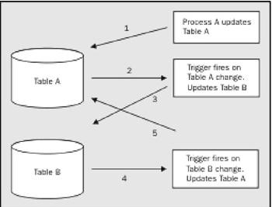

Slide 32
Embedded SQL
SQL statements contained within an application programming language
Host language: Any language that contains embedded SQL statements
Differences between SQL and procedural languages
Run-time mismatch
SQL is executed one instruction at a time
Host language runs at client side in its own memory space

Slide 33
Embedded SQL
Embedded SQL framework defines:
Standard syntax to identify embedded SQL code within the host language
Standard syntax to identify host variables
Communication area used to exchange status and error information between SQL and host language

Slide 34
Embedded SQL
Static SQL: Programmer uses predefined SQL statements and parameters
SQL statements will not change while application is running
Dynamic SQL: SQL statement is generated at run time
Attribute list and condition are not known until end user specifies them
Slower than static SQL
Requires more computer resources

